Slide 1
The Tax Cuts and Jobs Act
Impact on C Corps and S Corps
Charles J. Garrison, CPA
Joseph M. Press, CPA, CFE

Slide 2
Corporation and S-Corporation Tax Changes
Tax Rates
Deductions and “Pay-Fors”
Miscellaneous
Qualified Business Income (QBI) Deduction

Slide 3
Tax Rates
2017 2018
34% Taxable Income <$10MM 21%
35% Taxable Income >$10MM 21%
Also applies to Deferred Tax Assets and Liabilities
Tax rates for other than 12/31 year end

Slide 4
Deductions – the good news
Depreciation
2017 2018
$2.0MM Qualified assets placed in service $2.5MM
$500M Allowable §179 depreciation $1.0MM
Allowable §179 depreciation expense is reduced by the amount of assets purchased over the limit of $2.5MM. Expensing of real property also has been expanded.
100 bonus depreciation now available for qualified property placed in service after September 27, 2017 and before 2023.

Slide 5
Deductions – the good news
Vehicle (Luxury Auto) Depreciation
2017 2018
$1,475 First year expensing $5,760
$2,560 First year total depreciation $10,000
$4,100 Second year total depreciation $16,000
Pickups and large SUVs are still not subject to the luxury auto limits as long as the GVW exceeds 6,000 lbs.

Slide 6
Deductions – the good news
Cash Basis of Accounting
2017 2018
$5.0MM $25.0MM
Average Gross
Receipts Limitation
Allows for indefinite deferral of income tax on excess of receivables over payables.
Gross receipts still not limited for S Corporations.
IRS to provide automatic consent.

Slide 7
Deductions – the good news
Cash Basis of Accounting
Interest Receivable $800,000
Prepaid Expenses 255,000
Interest Payable (125,000)
Accrued Expense excluding taxes (165,000)
Net deferral of expense $765,000

Slide 8
Deductions – the bad news
Meals & Entertainment,
Employee Expenses Changes
2017 2018
50% Tickets to events -
50% Business entertainment (Golf) -
80% Contributions to colleges (seating) -
100% Employee transportation/parking -
100% Employee moving expenses -
100% Employer provided meals 50%

Slide 9
Deductions – the bad news
Meals & Entertainment,
Employee Expenses – No Change
Employee travel meals 50%
Other travel expenses 50%
Business meals 50%
Meals during entertainment 50%
Employee entertainment (Christmas party) 100%
Employee service awards 100%
Business gifts 100%
Association dues 100%*
* Subject to lobbying exclusion

Slide 10
Deductions – the bad news
Dividend Received Deduction
2017 2018
80% 65%
70% 50%
Dividend Received Deduction
>20% owned
Dividend Received Deduction <20% owned

Slide 11
Deductions – the bad news
Net Operating Losses (NOL)
2017 2018
100% 80%
2 yrs. None
20 yrs. Indefinitely
Offset of current year income with NOL
Carryback to NOL to
prior years’ income
Carryforward to
subsequent years’ income

Slide 12
Miscellaneous Items
Alternative Minimum Tax repealed under the TCJA
AMT credit carryforwards can still be used
AMT for other than corporations NOT repealed
State and Local Tax (SALT) deduction not
limited for other than individuals

Slide 13
Qualified Business Income (QBI) Deduction
Effort to equalize rates between C corporations and pass-through entities
Provides the potential to deduct up to 20 percent of QBI from S corporations and trusts as well as other entities
Possibly the most complex part of the legislation at both the pass-through and individual level

Slide 14
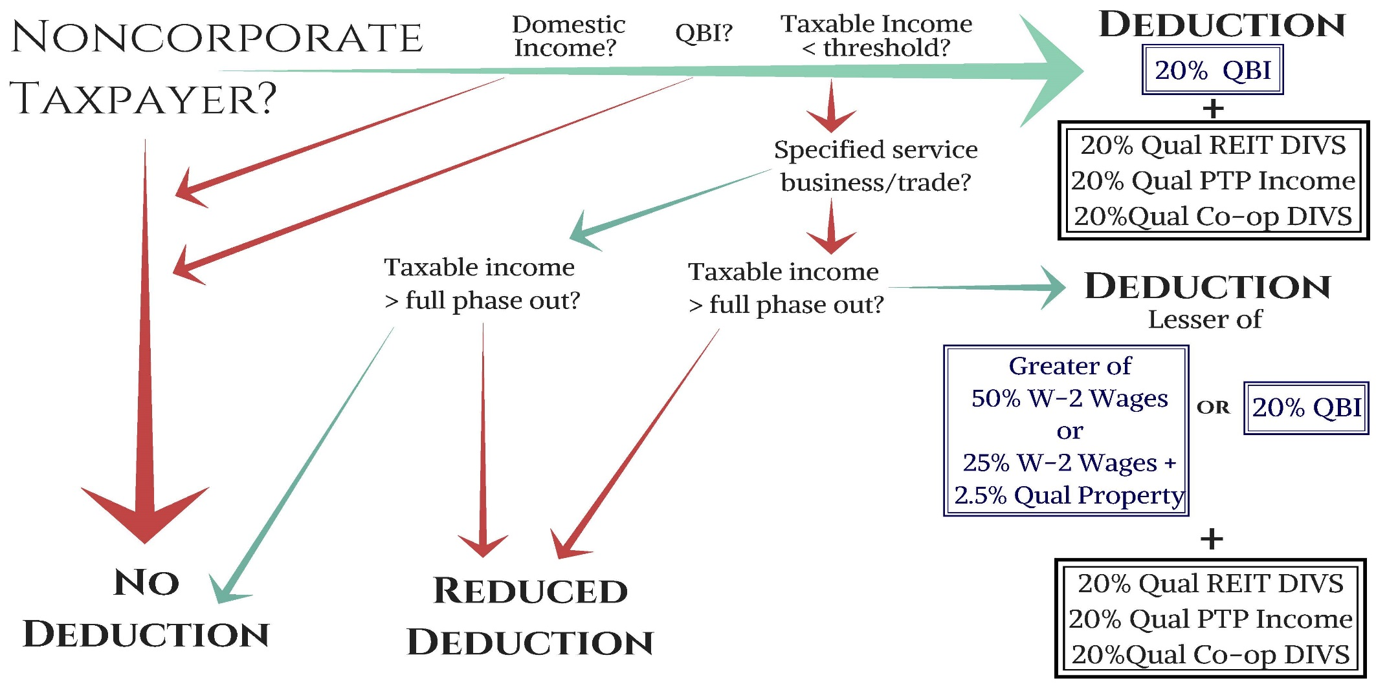
Pass-Through Business Deduction

Slide 15
Pass-Through Business Deduction Explanations
Non-corporate Taxpayer: S Corp, Partnership, Trust, Sole Prop., etc.
Domestic Income: Earned in the U.S. or Puerto Rico
QBI: Income from qualified trade or business except excluded items
Taxable income threshold: $157,000 single, $315,000 MFJ
Specified Service Trade or Business: not QBI
Taxable income full phase-out: $207,000 single, $415,000 MFJ
Reduced Deduction: Wage limitation and non-QBI income will determine the amount of the deduction, if any
Deduction limited to 20% of QBI

Slide 16
Specified Service Trade or Business (SSTB)
Accounting, Law, Consulting, Actuarial Science
Health Care, Performing Arts, Athletics
Investment Management, Brokerage, Securities Dealer
Financial Services – DOES NOT INCLUDE BANKING
Investment Management – The performance of services that consist of investing and investment management would include a trade or business that receives either a commission, a flat fee, or an investment management fee calculated as a percentage of assets under management.

Slide 17
De Minimis Rule
If gross receipts are <$25MM and SSBT income is <10% of gross receipts
If gross receipts are >$25MM and SSBT income is <5% of gross receipts

Slide 18
Reporting
While the Company must report necessary items to the shareholder/partner, the calculation is made on the individual level
Items that will likely need to be reported:
Interest, dividends, short and long-term capital gain/loss
Investment income
W-2 wages
Qualified property
Will require substantial revision to the Form K-1

Slide 19
LEGAL NOTICES AND TERMS
The information and materials in this presentation are provided by Fortner, Bayens, Levkulich & Garrison, P.C. (FBLG), for general informational purposes only. These materials do not, and are not intended to, constitute legal or tax advice. Your use of this presentation does not create a client relationship between you and any of the presenters or their company.
The information contained in this presentation is based on sources which we believed reliable but is not guaranteed by us and is not to be considered all inclusive..
This presentation and all the information and material it contains is the property of FBLG and we retain and reserve all rights therein, including all rights under copyright laws, trademark laws, international treaties and conventions and other intellectual property laws.

Slide 20
Fortner, Bayens, Levkulich & Garrison, P.C.
Fortner, Bayens, Levkulich & Garrison, P.C. is an accounting and consulting firm that exclusively serves financial institutions. Based in Denver, CO we have been in business since 1977 and our shareholders average more than 20 years of banking experience. We draw on our wide range of banking expertise to identify solutions for our clients.
We are a full service firm, but you can custom tailor our services to meet your institution’s individual needs. Our services include:
Asset Review Services
Audit Services
IT Security Risk Management
Regulatory Compliance
Tax Services
Certified Public Accountants ∙ A Professional Corporation
1580 Lincoln Street, Suite 700
Denver, Colorado 80203
303-296-6033 www.fblg-cpa.com

